Slide 1

GreenBytes
Recycle-Ray
Scan. Sort. Succeed
-
-

Slide 2
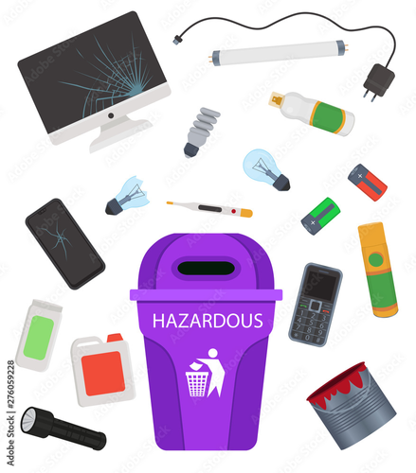
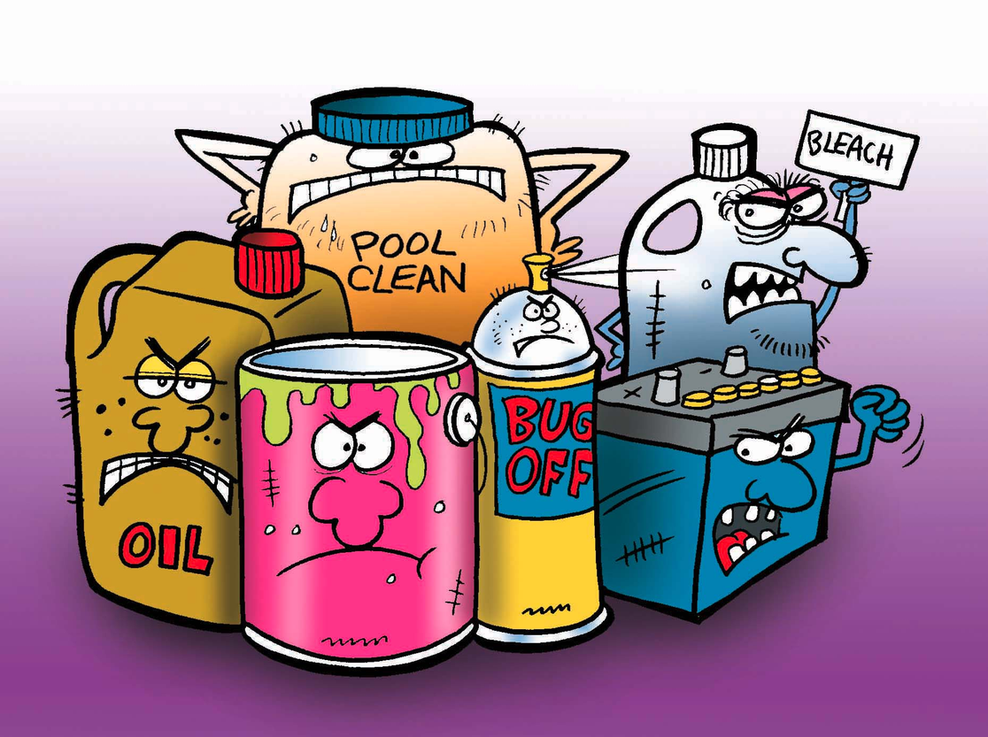
Problem Issue:
21% of blue bag content is residual waste
Harmful to sorting infrastructure
Challenges in vertical habitats
Ineffective communication

Slide 3
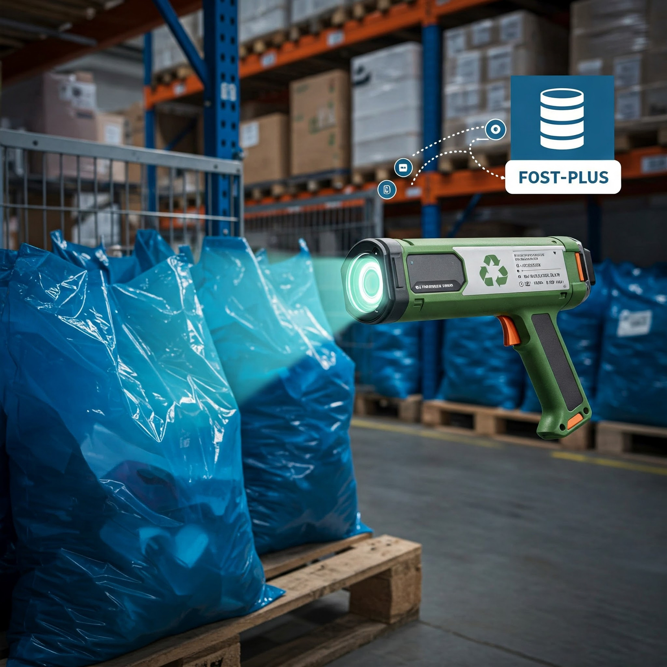
Our Team’s Solution
-
-
Recycle-Ray
Portable X-ray scanner: Detects harmful items in blue bags before they reach sorting facilities.
AI-powered recognition: Identifies non-compliant items with high accuracy.
Geo-location tracking: Logs contamination hotspots for targeted education campaigns.

Slide 4
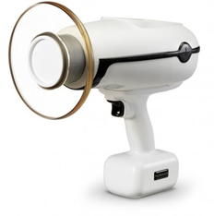
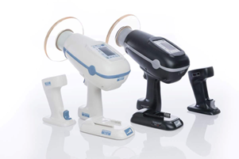

N1 Portable X-Ray
Used in dental care (Low radiation levels)
Safe
50000 - 100000 scans
507 Euros for 1
Maintenance cost: 1 519 Euros
Cost effective: 0.09621-0.192 Euros per bag

Slide 5
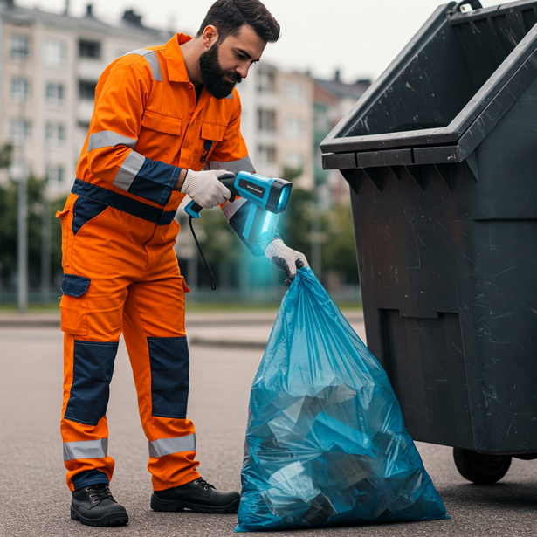
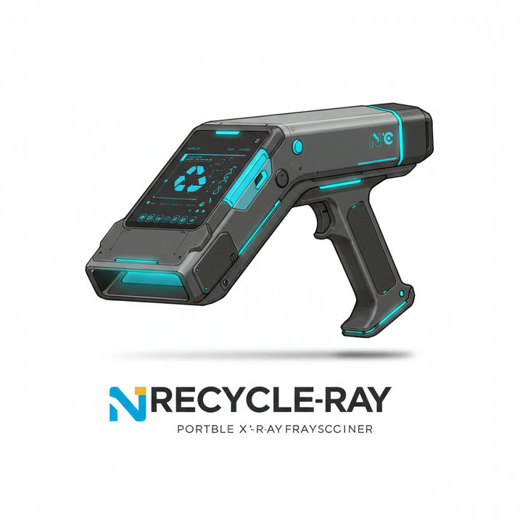
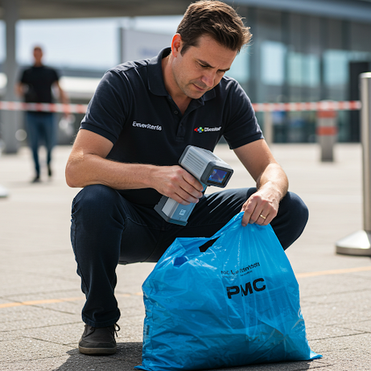
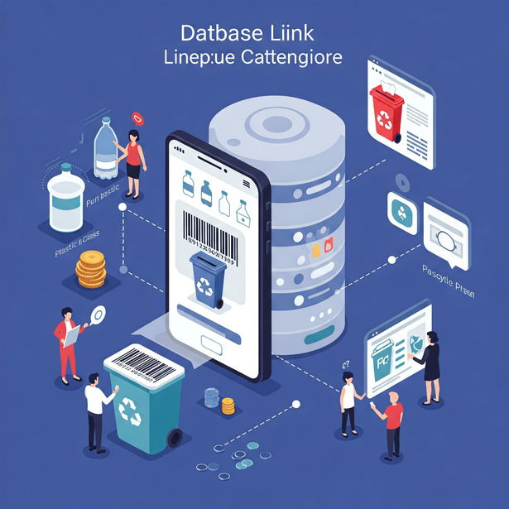
Recycle -Ray

Slide 6
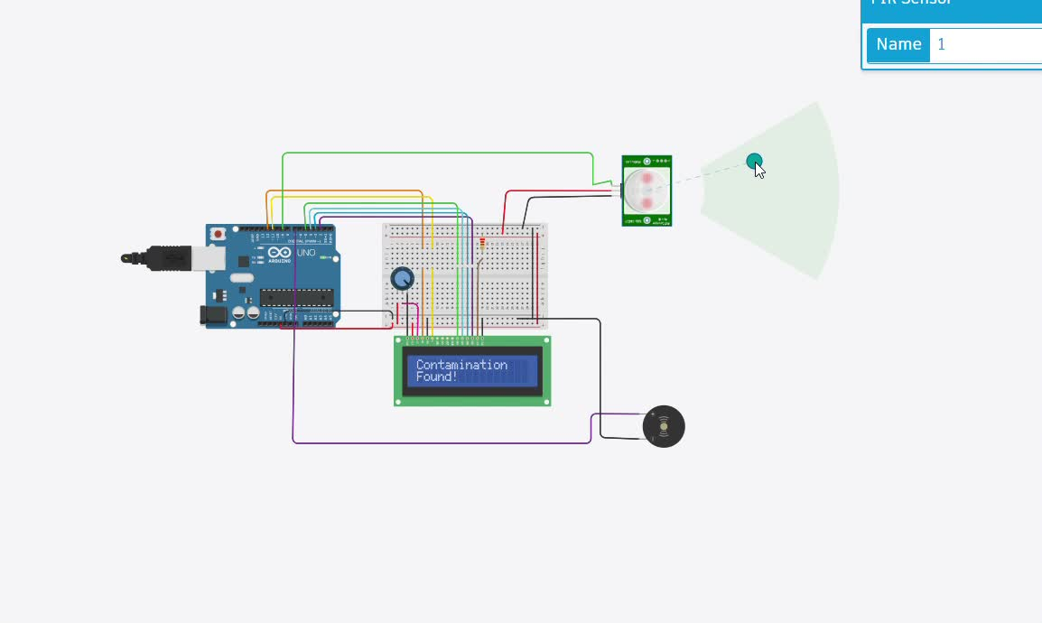
Prototype

Slide 7
Risk Assessment
Risk | Mitigation
High Initial Cost | Start with pilot program in selected cities before scaling.
Privacy Concerns (Geo-Tagging) | Ensure data is anonymized to avoid personal tracking.
Scanner Accuracy | Use AI to continuously improve detection rates.
Adoption Resistance | Partner with waste companies & governments for integration.

Slide 8
Business Model – Recycle Ray
Revenue Streams - Data Monetization
Geo-location and contamination data collected by Recycle Ray is highly valuable.
Insights for Waste Management: Identify contamination hotspots, optimize collection routes, and improve recycling efficiency.
Platforms like Kaggle: Share anonymized datasets with data scientists and researchers to drive innovation in waste management.
Partnerships with Tech Companies: Collaborate with AI and analytics firms to develop predictive models for waste sorting.

Slide 9


Key Partners
Osstem Device Manufacturer: Produces and supplies Recycle Ray devices.
Fost Plus: Primary customer and deployer of Recycle Ray.
Local Governments: Adopters of Recycle Ray for municipal waste management.
Tech Companies: Collaborators for AI, data analytics, and platform integration.

Slide 10
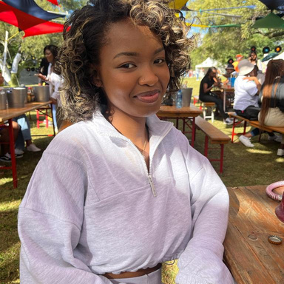
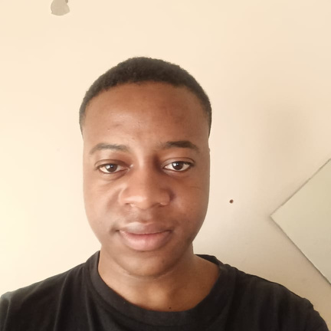
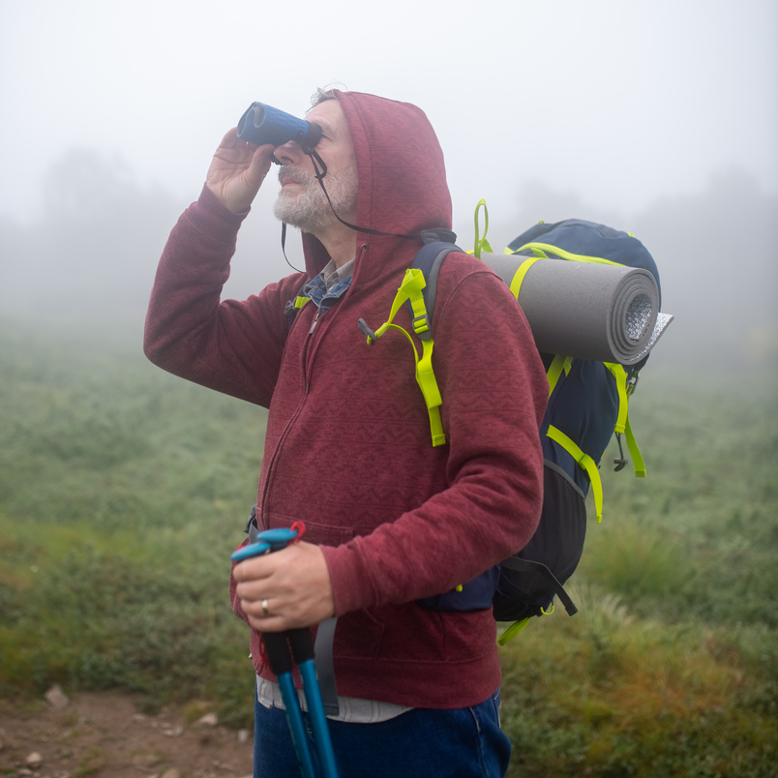

GreenBytes
-
-
Meet Our Team
Ntshepeng Makua
Felix Mandyme
Drydan Pienaar
Ralph Libens

Slide 11
SCAN
-
SORT
-
SUCCEED
Thank You
Recycle- Ray
-
-

